Slide 1
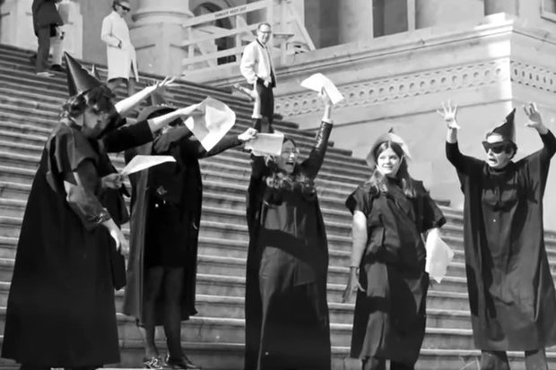
A witch’s Guide to Social, Political, and Spiritual Activism// (“Spirituality and Activism”)
By Ali Browne and Andrea Peterson As Presented to OLOTEAS via Zoom – 7/25/2020

Slide 2
Activism (n): “the policy or action of using vigorous campaigning to bring about social or political change”
What about the more “not so vigorous” means?
Witches are individuals who manipulate energy so that we can affect change.
You cannot be an effective activist without first deeply examining your inner self, nor can you be an effective witch without first working on the shadow self.

Slide 3
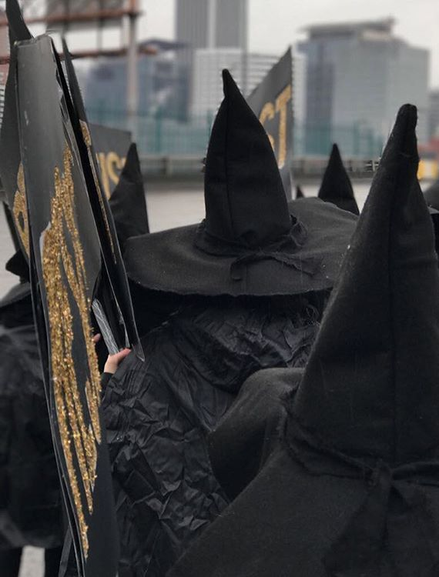
“Witches Against White Supremacy” and the BLM Movement
Slogans are great, so are memes, and so are the designers who create logos for movements, BUT-
How do we take a slogan and put it into activism beyond reposting on social media?

Slide 4
Ways to Level-Up Your Activism
Writing letters/corresponding with elected officials
Protesting
Organizing
Donating
VOTING! (So mote it be!)
Self-education through reading, listening to podcasts, attending workshops, and most importantly – LISTENING TO MARGINALIZED COMMUNITIES!
(All of these have space for practical applications for activist magick)

Slide 5
Examples of Activism in Witchcraft/Witch-Identifying Groups
Wicca/PAGANISM and environmentalism
Dianic Wicca and feminism
W.I.T.C.H. NYC/PDX/Boston AS A MODEL OF “COVEN ACTIVISM”

Slide 6
How do I approach my elected officials and does it really count?
YES! Even when you think you’re being given a form letter as a reply, or you think you’re not being heard, you’re at the very least pissing off an intern who has to log every bit of correspondence an elected official receives.
Magickal application:
Amplification/energetic raising of electronic messages. BELIEVE it has a huge impact.
Draw sigils or anoint with oils if a physical letter.

Slide 7
Practical Activism: A Primer on Engaging Lawmakers
General Ground Rules
Use respectful language. Respectful correspondence gets a response. Belligerence and name calling do not.
Be specific about what change you are looking for. Are you looking for a policy or funding change? What specific change are you looking for?
Example:
I want our police department to be more accountable versus
Make police disciplinary actions a matter of public record
Example:
Please give more money to education versus
Professional Education Association XYV says that this sum of money would fully fund education in our state. Please make sure that education is funded at this level.

Slide 8
Practical Activism: A Primer on Engaging Lawmakers (Continued)
If possible, make it personal. Policymakers need to know how their work impacts people on a tangible level.
Example:
Policy X is bad for business versus
Policy X negatively impacts my company which employs 15 people. If this policy continues, my business and other businesses like mine will be forced to close. This will put hundreds of people in our state out of work.
Be succinct. No one has time to read novels, but you also need to get your point across. Contextualize the problem and propose your solution. Move on.
Stick to one or two issues you are truly passionate about. If you are constantly calling your lawmaker about everything, staffers will tune you out. Pick a cause, and stick to it.

Slide 9
Practical Activism: A Primer on Engaging Lawmakers (Continued)
Before You Engage
Do your research! If it sounds like you’ve put thought and time into the issue, people will listen to you more. Know something about your subject.
Know what level of government would help you best! Should you be working at the local, state, or national level? For example, if the issues are about teachers or police, you’re probably best working with state and local governments. If it’s national security, federal lawmakers are best. Never underestimate the amount of change that local governments can bring.
Make sure you are contacting the correct lawmaker. If you do not live in a lawmaker’s district, your message will be disregarded.
Use Google or any other search engine to find out who your local, state and federal representation are.
Bonus: If you know what committees a member works on, you will know where they are most able to make a change.

Slide 10
Practical Activism: A Primer on Engaging Lawmakers (Continued)
Methods of Engagement
Calling
This is most effective in expressing support or opposition to a bill that is actively being marked up (amended) or being voted on.
Offices take note on the number of calls that they get on a bill
You can also call to express your position on something as well as ask the member’s stance on a particular issue. You have the right to request a call back from staff that works on that issue.
In-Person Meetings
This is more effective if you want to discuss in-depth a policy/issue that may or may not have a bill associated with it. It’s also great for conveying a compelling situation.
On a federal level, you can request a meeting with the member of Congress either in DC or in a local office. You will often meet with a staffer who works on the issue that you want to talk about it. The same is true for local issues, the lawmaker or staff assistant may take the meeting.

Slide 11
Practical Activism: A Primer on Engaging Lawmakers (Continued)
Social Media:
This is most effective in expressing support or opposition to a bill that is actively being marked up (amended) or being voted on. Just be sure to include the appropriate mentions and tags.
Stalk the lawmaker to see how the use social media to get the most out of this medium.
If you are looking to write more extensively on an issue, it is better to send a letter or email.
Letters/Emails
Emails and physical letters are best if the issue is not particularly time sensitive (bill is not being actively) voted on.
Townhalls
Lawmakers often have informal sessions to meet with constituents. This can take the form of a coffee roundtable to a larger meeting.
This is an underestimated method of engagement.
This is your time to express your opinion on a matter and ask questions directly/in-person
Bring friends who may have something to add to the conversation
Follow the lawmaker’s website or social media for townhall times and locations.
Amplifying Your Message

Slide 12
Protesting Magickally
Protection through the use of sigils
Safety
Preparation
First Aid
Aftercare

Slide 13
Protective Sigils for Protesters/Anti-Racism
PLEASE follow Laura Tempest Zakroff on Instagram @owlkeyme.arts
Sigil for the Protection of Protesters
2020 Freedom Sigil
Sigil for the Dissolution of Hate

Slide 14
Safety and First Aid
Before:
Hydrate magickally
Use stone-infused water (recommended that you utilize your ability to research- pyrite ain’t the one, henny!)
Honoring the element of water: be adaptable, carve change into the symbolic landscape, shift
Moon water, especially in a fire sign, is helpful.
Ground and shield- you are spiritually capable!
Meditate on your objectives. Visualize them. Visualize change. Visualize the elevation of oppressed peoples.
Envision your connectedness, envision your power growing. You CAN make a difference!
ALSO PLEASE EAT SOMETHING. USE THE RESTROOM. One cannot pour from an empty cup. Check in with your body, mind, and spirit.

Slide 15
Safety and First Aid, continued: Backpack Essentials
Level 1: Rally/Vigil
Water
Snacks
Sunscreen
LISTENING SKILLS!
Level 2: Peaceful Protest
Contents from Level 1 +
Emergency contacts, ID, Medical insurance card, and medical info like blood type in plastic Ziploc bag
WRITE LEGAL AID #s on YOUR ARM!! In Sharpie!
Freeze water bottles to drink as they melt
First Aid Kit
Insect Spray
Snacks (nuts and protein bars and beef jerky work especially well)
Phone in plastic bag, not out taking photos of other activists!
Level 3: Protesting After a Non-Peaceful Event (Escalated Aggression)
Earplugs (for LRAD devices)
Goggles (please make sure they have a seal)
Kneepads/heat resistant gloves
Helmet
½ Antacid, ½ water mixture in a sports bottle
First Aid Kit Change of clothing – NOTHING POLITICAL!
Contents from Level 1 & 2 Cop-proof phone in plastic bag, not out taking photos of other activists!
RECOMMENDED READING: “How To Cop-Proof Your Phone Before Heading to a Protest”/ GIZMODO - https://gizmodo.com/how-to-cop-proof-your-phone-before-heading-to-a-protest-1843828887

Slide 16
“What to Do If” (Knowing Your Rights)
Know Your Rights When Protesting
(From handout 6/4/2020, Duncan Plaza, New Orleans, LA)
-When you protest, bring a buddy, and wear nondescript clothes and shoes you can move in. You have a right to hold signs and hand out flyers. If cops issue a dispersal order, they need to provide clear notice and an opportunity to leave.
-If you bring your phone, disable fingerprint and Face ID unlock. Don’t unlock your phone for cops. They can’t search your phone without a warrant or consent. Use the Signal app to text others. Turn off GPS, NFC, Bluetooth, WiFi, and location services. Review social media privacy settings to limit who can see posts. Avoid tagging or posting identifiable images of people without permission.
-If cops stop you, ask if you’re free to go. If cops say that you’re not under arrest, but are not free to go, you are being detained. They can pat down the outside of your clothing if they have reason to believe you might be “armed and dangerous.”
-If cops search you, (inside of pockets, under shirt) or your things (inside of bag, wallet), tell them you don’t consent. If cops search you anyway, tell them again, as it may be recorded.
-If cops question you, before, during, or after arrest, you don’t have to answer their questions. They’ll try their hardest to get you to: they’ll tell you it’ll help you out, it’ll get you home faster, it won’t get you in trouble. Be clear: tell them you don’t wish to speak to them until you have a lawyer present. After you do that, don’t say anything more. There’s bad law that lets cops question you after your initial invocations of rights if you start talking again. Don’t tell the police anything except your name, address, and date of birth. You can invoke these rights (to silence, to a lawyer) at any point, even if you’ve already made a statement to the cops. Just be clear.
-If cops arrest you, call the NLG’s jail hotline at 415-285-1011. Sharpie this number (and the number of an emergency contact) on your arm. After arrest, don’t consent to a DNA swab without a warrant or court order. Try to keep your mask and PPE with you; if cops take it, tell them you don’t consent to DNA testing.
-If cops arrest someone else, get name, DOB.
These are your rights, though cops might not respect them. Above all, be safe.
Information from lawyers, not legal advice.

Slide 17
What to Do If (First Aid and Hazards of the Trade)
If you become injured in any part of a march or protest, it is 100% okay for you to take a break and/or retreat to safety. You can’t be an effective ally if you are hurt in any capacity.
Possibilities:
Sprained/pulled muscles
Dehydration
Exhaustion (some marches can last up to 10 miles or more)
Insect/arachnid bites
Cuts/scrapes/bruises
Pepper spray
CS gas
Rubber bullets/”rubber balls”/projectiles

Slide 18
First Aid: CS Gas
DO NOT PANIC! Panicking makes the effects last longer.
Walk (slowly, so as not to cause a stampede) away from canister, and only touch/dispose of canister if you are wearing heat resistant gloves and protective gear
Flap your arms “like a bird” as you are walking away- it is a powder, not a gas, and the particles “stick” to you- so make sure you are not wearing any lotions, makeup, oils or Vaseline beforehand
Do NOT rub it in
Try to blow your nose/cough/spit, CALMLY, as breathing in heavily and swallowing will further agitate symptoms.
Change clothing carefully if you packed a change of clothes in your backpack.

Slide 19
First Aid: CS Gas (How to Treat)
Remedies:
We have been doing trials with pepper spray to find good remedies.
There are some things that you can do after being sprayed to help minimize
the discomfort. None of these are miracle cures: using these remedies will
help people to feel better faster, but it will still take time.
• For the eyes and mouth:
We recommend an eye flush using a solution of half liquid antacid
(Maalox) and half water.
A bottle with a squirt cap is ideal for the eye flush. Always irrigate
from the inside corner of the eye towards the outside, with head tilted
back and slightly towards the side being rinsed. It needs to get into
the eye to help. You may need to help open the victims’ eye for them
- they most likely won’t be able/ willing to open it themselves, and
opening will cause a temporary increase in pain, but it does help.
This works great as a mouth rinse too, as long as the victim is alert
and breathing normally. Spit it out after rinsing.
• For the skin:
We recommend treating small areas at a time with MOFIBA
(mineral oil followed immediately by alcohol)
Caution: in order to perform this procedure correctly, you need
to be trained. If done improperly, harm can be done. Carefully avoid the eyes.
SOURCE: Activist’s Guide to First Aid (available as a .pdf)

Slide 20
Aftercare: CS Gas and Herbalism for Trauma
Lung support:
A tincture of Mullein leaf (Verbascum thapsus) is excellent lung support.
This should especially be used if you are asthmatic or have a cough. You can take two to four dropperfuls, every four hours or so, immediately following exposure. After a day, decrease this to two dropperfuls four times a day.
Chewing on the root of a licorice plant (Glycyrrhiza glabra) is also very
helpful for your lungs, as are Slippery Elm tablets or capsules of Marshmallow root powder (Althea officinalis). These mucilaginous herbs all soothe and coat mucous membranes. These are especially important if you have a dry cough.

Slide 21
Aftercare: CS Gas and Herbalism for Trauma (Continued)
• High fiber diet:
Whole grains or psyllium husk can help clean you out your colon . Always
take psyllium with at least two cups of water. Discontinue if irritation or gas
occurs.
• Epsom salt rub:
A hot shower, followed by a thorough scrubbing with epsom salts which are
then left on the skin for 10-15 minutes before a thorough follow-up wash can
help draw toxins from the body. Be sure to accompany this with much water
consumption.
• Nettle tea:
Nettles are the perfect all around support plants. Their high mineral content
and mild cleansing action supports many body functions. Drinking lots of
nettle tea will boost your immune system, calm you down and support your
body in returning to its regular, strong self.

Slide 22
Aftercare/ Herbalism for Trauma (Continued)
Emotional Aftercare:
Some people hold stress in their bodies following demos. This can show up as disturbed sleep, nightmares, anxiety, fear or depression. It can also trigger underlying stress from past events.
A good formula for supporting the nerves and relieving stress is equal parts:
• Skullcap (Scutellaria lateriflora)
• Lavender (Lavandula spp.)
• Oatstraw (Avena sativa)

Slide 23
Other Ways to be an Activist Witch/Pagan
ORGANIZING!
Utilize social media
Design a support group for other witches/pagans (because being a witch/pagan is never apolitical) around “outer layer” issues like “dealing with my racist parents,” or “how to be an environmentalist when you’re broke” so that you can focus collaborative intentions together. This is a discussion circle, not a coven.

Slide 24
Other Ways to Be an Activist Witch
Authoring petitions:
Utilize sigils in the same manner you would with certain goals: “do as I say” and “abundance” spells help.
FOCUS your energy on your goal, and act as if it has already happened.

Slide 25
Donate, Donate, Donate!
Money
Use your favorite multiplying/abundance/prosperity spell to increase your donations/matches in donations.
You can do this electronically as well as physically. Every time you hit that “donate” button on a nonprofit website, say your words LOUD and PROUD and FOCUS! Light a green candle or use basil, etc.
Resources
Water, snacks, sandwiches, first aid kits for active protesters
Clothing, food, etc. to the unhoused
Time and service

Slide 26
What Now? (How to “Keep the Fire”)
You cannot be an effective ally if you are pouring from an “empty cup”
You must be able to return to action in a persistent manner and not “burn out.” The success of social movements depends on you.
Give yourself time to recharge.
Meditation
Yoga
Reiki
HEAL THYSELF!

Slide 27
Consulting with Deity Regarding Your “Path” When Pagan
GODS FOR JUSTICE:
Anbay, Baldr, Datin, Enlil, Forseti, Haukim, Hendursaga, Honos, Issitoq, Jupiter, Mandanu, Marduk, Mitra, Nahundi, Ninsusinak, Pugu, Shani, Shiva, Sydyk, Takhar, Týr, Utu, Varuna, Yama (Buddhism and Hinduism), Zeus
GODDESSES FOR JUSTICE:
Adrasteia, Adrestia, Ammit, Astrea, Athena, Dike (mythology), Eirene, Eunomia, Homonoia (mythology), Horae, Inanna, Lady Justice, Maat, Mafdet, Nanshe, Nemesis, Praxidice, Syn, Themis, Vár

Slide 28
The End.
To Read: Witchcraft Activism: A Toolkit for Magical Resistance by David Salisbury Revolutionary Witchcraft: A Guide to Magical Activism by Sarah Lyons “The Personal is Political” – 1970 – Essay by Carol Hanisch To Listen (Podcasts): The Witch Daily Show (Tonya Brown) – Episodes 263 & 272 3 Pagans and a Cat – Episode 95 (Protest)

